Slide 1
Helping Clients Benefits From Unwanted/Unneeded Life Insurance Policies

Slide 2
Current Life Insurance
Market Statistics
First Life Insurance Company
U.S. Leading Insurance Premium Writing Country
291 Million Life Insurance Policies in Force
$20.3 Trillion in Face Value
$602 Billion of Life Insurance Benefits Were Surrendered - American Council of Life Insurance Fact Book of 2015
Insurance Settlements
Rehbu
rg Life

Slide 3
Senior Life Insurance Market
Over Age 65:
38 Million Life Insurance Policies
Face Value of More than $3 Trillion
Over Age 70:
$257 Billion in Whole Life
370 Billion in Universal Life
$60 Billion in Variable Universal Life
Expanding Senior Population – 42 Million in 2012 to an estimated 70 Million in 2030

Slide 4
According to the Insurance Studies Institute, more than 500,000 seniors lapse their life insurance policies annually, only 1250 take advantage of a life insurance settlement. About 90% of seniors report that they would have considered a life insurance settlement if they had been made aware of the option.
Did You Know?

Slide 5
What Is A Life Insurance Settlement?
A life insurance settlement is a financial transaction in which a policy owner sells an unwanted or unneeded life insurance policy to a third party. The purchaser becomes the new owner and beneficiary of the policy and is responsible for all subsequent premium payments but gets the death benefit.

Slide 6
The Evolution Of Life Insurance Settlements
1911 – Grigsby v. Russell
1980’s – AIDS Epidemic
1995 – Life Insurance Settlement Association (LISA) Formed – Only 3 states had regulations
2008 - Over 30 new laws have been passed to strengthen consumer’s rights and create a more sound and transparent regulatory structure for market participants. NCOIL and NAIC
Today - $25.1 billion in force, $2.4 billion annually. Regulated 46 states and Puerto Rico. 7 states mandate insurance companies disclose options to lapse or surrender

Slide 7
Life Insurance Settlements: Benefitting Your Client…and You!
Poll Time

Slide 10
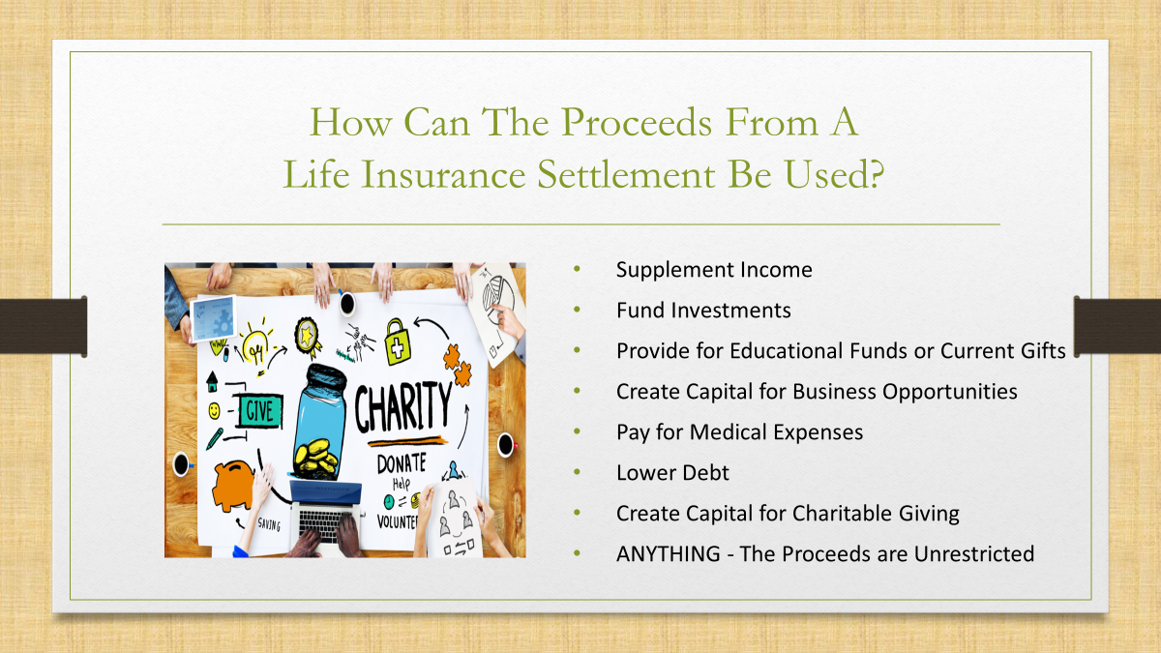

Slide 11
More Is Better
After all alternatives have been considered and the conclusion is that it is time to lapse or surrender a policy, a life settlement can offer significantly greater value!
Let’s Look at Some Academic Proof…

Slide 12
Academic Proof
2002 – Wharton School
1584 Policies
$93.4 Million Cash Surrender Value
$336.3 Million Life Settlement Value
2010 U.S. GAO Report – U.S. Govt. Accountability Office
1020 Policies
$37.4 Million Cash Surrender Value
$269 Million Life Settlement Value
2013 London Business School
9000 Policies - $24 Billion in Death Benefit

Slide 13
Who Are The Investors?

Slide 14
Who Are The Investors?

Slide 15
How Much Is A Policy Worth?
1) $250,000 Policy = $128,500
2) $250,000 Policy = $75,000
3) $250,000 Policy = $8,000

Slide 16
Are There Any Negatives?
Taxes
Being Able to Obtain Additional Life Insurance
Government Funding Reduction
Creditor Debt

Slide 17
The Process
Application
Copy of the Policy
Medical Records
Illustration
Offer Made
Escrow

Slide 18
Consumer Protections
Transparency

Slide 20
Life Insurance Settlements: Benefitting Your Client…and You!
Poll Time

Slide 21
The Big Picture
WIIFY?

Slide 22
Getting Over the “Ick” Factor
How to talk to a client about selling a policy

Slide 23
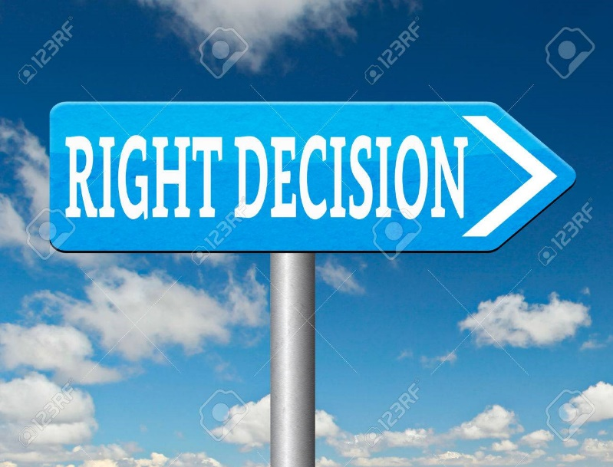
Life Insurance Settlements
Right For Your Clients?

Slide 24
Helping People Benefit from Unwanted/Unneeded Life Insurance Policies
Free - No Obligation Appraisals
Lisa Rehburg
(714) 349-7981
lrehburg@aol.com
Rehburglifesettlements.com

